Slide 1
Amplitude Modulation and Demodulation
Communication System Lab Project
Section C-2
Muhammad Saad 20-EE-103
Ali Hassan 20-EE-87
Muhammad Hamza 20-EE-127
Usama Hanif 20-EE-23
Eesha Nasir 20-EE-71

Slide 2
OBJECTIVE
Assemble amplitude Modulator circuit
Assemble amplitude demodulator circuit
Apply modulation Technique to audio input

Slide 3
INTRODUCTION
An Amplitude Modulated signal is composed of both low frequency and high frequency components.
The amplitude of the high frequency (carrier) of the signal is controlled by the low frequency (modulating) signal.
The envelope of the signal is created by the low frequency signal.
If the modulating signal is sinusoidal, then the envelope of the modulated Radio Frequency (RF) signal will also be sinusoidal.
This would be the case in a common AM radio.
The low frequency signal would be an audio signal and the high frequency would be the transmitting frequency of the AM radio station

Slide 4
COMPONENTS
Ac source
Vero board
Diode
Capacitor
Resistor
Transistor
Function generator
Oscilloscope
Microphone
Speaker

Slide 5
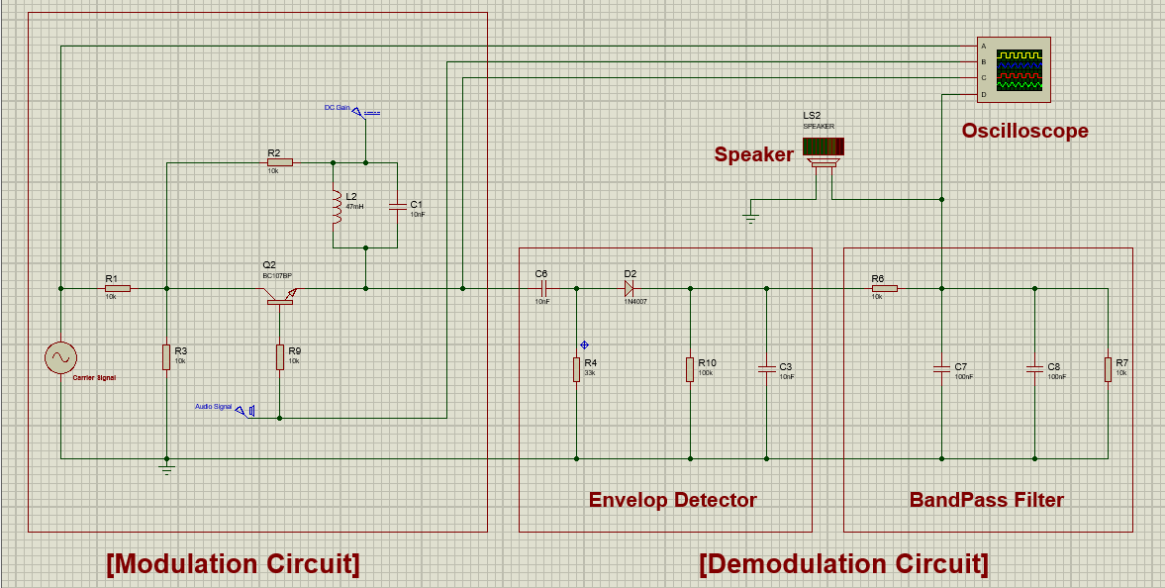
CIRCUIT DIAGRAM

Slide 6
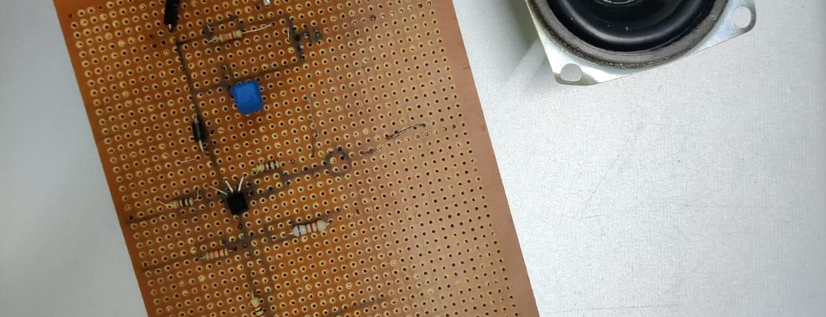
CIRCUIT ON VEROBOARD

Slide 7
WORKING
AM modulation can be achieved using a basic circuit that includes a resistor, a capacitor, and a transistor.
The carrier signal is input into the base of the transistor, which amplifies the signal and applies it to the collector.
At the emitter side we apply the message signal which is then applied to the collector.
The collector then multiplies both the message and carrier signals and AM modulation takes place.
For AM demodulation, a diode can be used as a detector circuit.
The diode rectifies the incoming modulated carrier wave by allowing only the positive half of the wave to pass through.
The rectified signal is then passed through a low-pass filter made up of a resistor and capacitor.
This filter removes the remaining high-frequency components of the carrier wave, leaving only the original information signal.

Slide 8
CONCLUSION
we are successful to develop a communication system based on amplitude modulation through the design of transmitter & receiver.
It is functioning properly.
designing and implementing the system, we are always concerned about the economical design.
We have also designed AM radio receiver to receive the broadcasting radio signal.

Slide 9
REFRENCES
Communication systems, Simon Haykin- 4th edition. ISBN 9971-51-305-6. Operational Amplifiers and linier integrated circuits, Robert F. Coughlin, Frederick F. Driscoll-6th edition. ISBN-81-203-2096-4.: Modern Digital and Analog Communication Systems, by Lath-4th Edition

